Slide 1
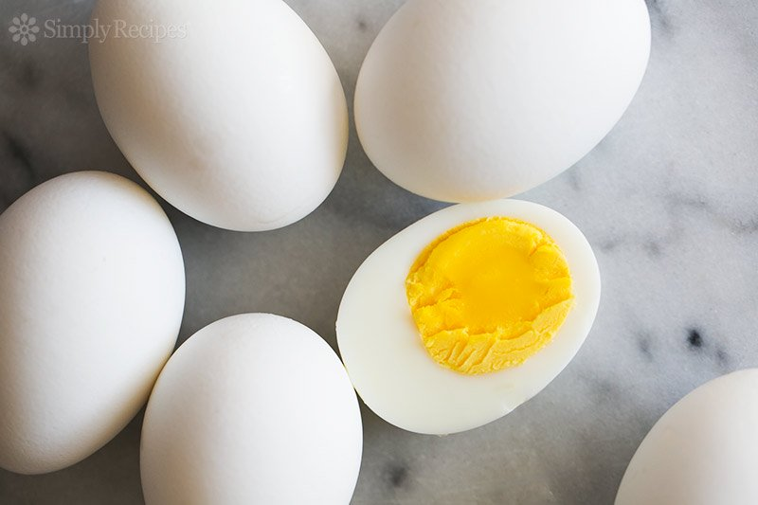
Topic – Structure & Composition of Egg Subject – Food Science & Current Trends MHSC - Food & Nutrition
Neeta Khare
Asstt. Professor, Home Science
MJB Girls PG College, Indore

Slide 2
Contents
Introduction
Structure of an Egg
Composition of an Egg

Slide 3
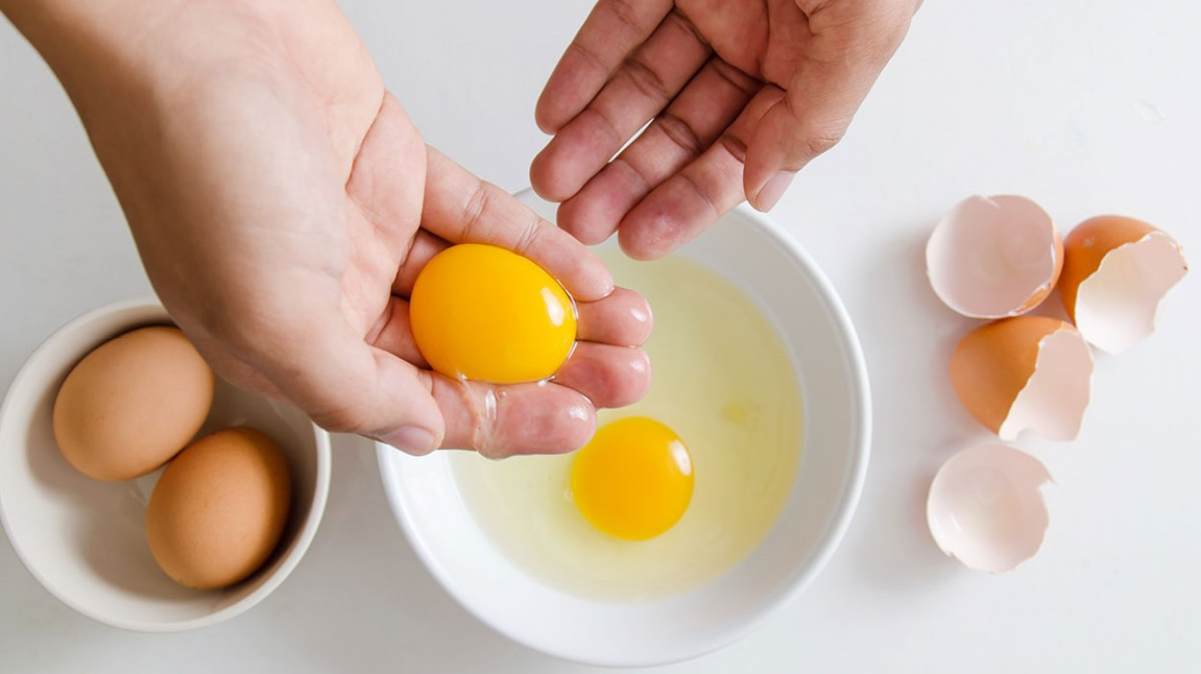
Introduction
Eggs of all birds may be eaten. The egg of chicken is used more often than any other.
Eggs are an expensive source of protein.
Eggs are used as reference standards against which all other protein containing foods are assessed.

Slide 4
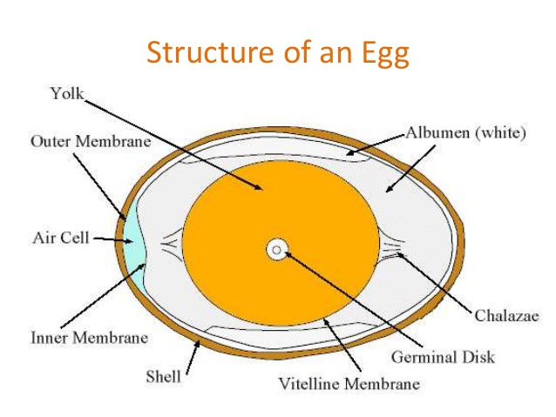
Structure of an Egg
An egg basically consists of three parts :
Shell
Egg white
Egg yolk

Slide 5
Egg Shell
Protective covering of the inner contents composed of calcium carbonate.
It has two membranes.
It is porous and contains 1000 of air holes.
They are covered by cuticle to prevent the entry of microorganisms and excessive evaporation.
It can be removed by washing.

Slide 6
Shell Membrane
Two membranes- Outer (48 micro meter), Inner (28 micro meter).
Made up of protein and polysaccharides.
Outer layer- 6 layers of fibres, Inner layer- 3 layers of fibres.
Both are loosely attached at the broad end of egg.
Air cells forms after laying due to shrinkage of inner content – due to the difference in temperature.

Slide 7
Egg White
The white of an egg consists of three layers : 2 thin layers and 1 thick layer.
Ratio may vary depends on the varieties.
Some hens secrete a higher ratio of thick to thin white than do others.
Storage conditions also affect the thickness of the albumin and the ratio of thick to thin egg white.

Slide 8
Egg Yolk
The yolk of an egg is enclosed in a sac called the vitelline membrane.
Adjacent layer is Chalaziferous layer – appears like twisted ropes at both ends.
It has germ spot.
Layered into white and yellow but not distinguishable.
Infertile eggs are known as vegetarian eggs.

Slide 9
Composition of Egg
Percentage distribution of components of egg
Egg shell - 8-11%
White - 56-61 %
Yolk - 27-32%
Egg Shell
Egg shell is composed by following components :
Calcium Carbonate – 93.05%
Magnesium Carbonate – 1.39%
Phosphorus pentoxide – 0.76%
Organic Matter(matrix protein and polysaccharide) – 4.15%

Slide 10
Composition of Egg
Egg White
Egg whites consist of 88% water, 11% protein and 0.2% fat. Different types of protein are present in egg white as below :
Ovalbumin
55 % of egg protein.
phospho glycoprotein (A1, A2, A3 – 32:12:3)- mannose and glucosamine.
readily denatured by mechanical agitation (whipping).
Conalbumin
13% of egg albumin –without phosphorus and sulphur.
Easily coagulated by heat.
Ovamucoid
10% of egg white, glyco protein.
Exists in three forms, resistance to heat.

Slide 11
Composition of Egg
Avidin
0.05% of the egg white.
Binds biotin and make it unavailable.
Heat denatures the avidin.
Ovoglobulin
responsible for foam formation.
Ovainhibitor.
0.1%.
Inhibits trypsin and chymotrypsin.

Slide 12
Composition of Egg
Ovamucin
Responsible for jelly like structure of egg white.
2% of egg white.
Insoluble in water but soluble in diluted salt solution.
Present in 4 times than thin layer.
Lysozyme
3.5% of egg white is lysozyme.
Destruct the cell wall of microorganism.
Present three to four times in hen than duck egg.

Slide 13
Composition of Egg
Egg yolk
Egg yolk is composed of 32.5% fat, 17.5% of protein and 48% water. Solid content of yolk is about 50%.
The major proteins in egg yolk are :
Lipo protein : lipovitellins and lipovitellinin
Lipovitellins : High density lipoproteins (16-18% of egg yolk)
Phosvitin : 5-6% of yolk solid
Livetin : 1-10% of egg yolk
Low density lipoprotein

Slide 14
Composition of Egg
Fat in the egg Yolk
Fat of egg yolk consists of triglycerides, phospholipids and lipoproteins.
The main phospholipids is lecithin.
Lipoproteins are complexed with phospholipids and cholesterol.
The main fatty acids in the triglycerides of the egg yolk are oleic, palmitic, linoleic and stearic acid.
Minerals and Vitamins in Egg
Rich source of biologically available zinc.
Calcium in shell.
Vitamin C is absent.
Good source of fat soluble vitamins.

Slide 15
Thank You

